Slide 1
Evaluation

Slide 2
Evaluation
You have learned an inference engine / classifier. How good is it?
What is the relevant measure?
How can you estimate it from labeled corpus?
Note that there are three uses of a measure:
ML algorithm uses an evaluation measure as the thing to optimize e.g. by gradient descent. In that case, the measure has to be automatically computable, reasonably quickly.
Compare one classifier against another. Meta-analysis.
Predict the usefulness of your classifier in future.

Slide 3
What is the right measure?
For discrete classifiers, the standard measure is accuracy.
Accuracy = fraction of instances correctly classified.
But not always.

Slide 4
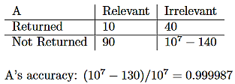
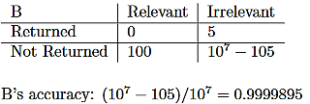
Why accuracy isn’t always the right measure
If you give a web search engine a query with a small number of results, you can consider it a classifier, where the category is “this page is relevant to my query”.
Now suppose we have two web search engines A and B. For some query, A returns 50 pages of which 10 are relevant. B returns 5 pages of which 0 are relevant. Suppose that the web has 10⁷ pages of which 100 are actually relevant to the query

Slide 5
Precision and Recall
C = the actual elements in the category in T.
Q = the elements labelled by the classifier as being in the category.
Precision = |C ∩ Q | / |Q| = Prob(C|Q)
Recall = |C ∩ Q | / |C| = Prob(Q|C)
For A, Precision = 10/50 = 0.2. Recall = 10/100 = 0.1.
For B, Precision = 0/5 = 0. Recall = 0/100 = 0.

Slide 6
F-Score combines precision and recall into one number.
Harmonic mean. 1/F = ((1/P)+(1/R))/2. F = (P+R)/2PR.
For P=1/5 and R=1/10, F = 1/((5+10)/2) = 1/7.5 = 0.13
Properties of harmonic mean:
Always less than the average, unless P=R.
If P and R are close then F is close to their average.
If P is substantial and R is close to zero, then F is about 2R; and vice versa.

Slide 7
Precision/Recall trade-off
Classifiers often compute, not a fixed set, but scores for each item X of how likely they think it is that X is in the category.
One can then define a set by deciding on a threshold τ and selecting all items whose score is greater than τ.
Let Q_{τ} be the set of items scored greater than τ. Obviously, if λ < τ, then
Q_{λ} ⊃ Q_{τ} , and C ∩ Q_{λ} ⊃ C ∩ Q_{τ}
So as τ decreases, recall steadily increases. Precision presumably tends to decrease --- if the classifier is any good at all, there are a higher fraction of actually relevant items among the high scores than among the low scores. But it has a jagged up-and-down pattern. Each time lowering τ adds another relevant item, the precision goes up a little; each time it add another irrelevant item, precision goes down a little.
So you can trade-off precision vs. recall by choosing the value of τ.

Slide 8
More generally
A “false positive” is an item that is not actually in the category, but the classifier (or test) reports to be in the category. (It is falsely reported to be positive.)
A “false negative” is an item that is in the category but the classifier reports is not in the category. (It is falsely reported to be negative.)

Slide 9
Specialized evaluation functions:
Machine translation
For AI tasks that are not simple classification, finding an effective, automatable evaluation metric can be challenging.
Machine translation. Many-to-many relation.
Gold standard: Ask bilingual speakers the quality of a proposed translation.
BLEU score. Measure based on the number of k-grams (sequences of k words) in common between the output translation and reference translations.
  Claim: Much of the progress in machine translation is a consequence of having the BLEU score as a metric to optimize.
  Anecdote: BLEU score becomes a fetish, with important papers being rejected because they don’t have a measurable impact on BLEU score.

Slide 10
How to use labelled corpus for evaluation
Idea 1: Train on entire corpus, and evaluate on entire corpus.
Problem: Does not detect overfitting. On the other hand:
  It gives an upper bound.
  If you are confident that you are not overfitting, (e.g. you are doing linear classification) it’s OK.

Slide 11
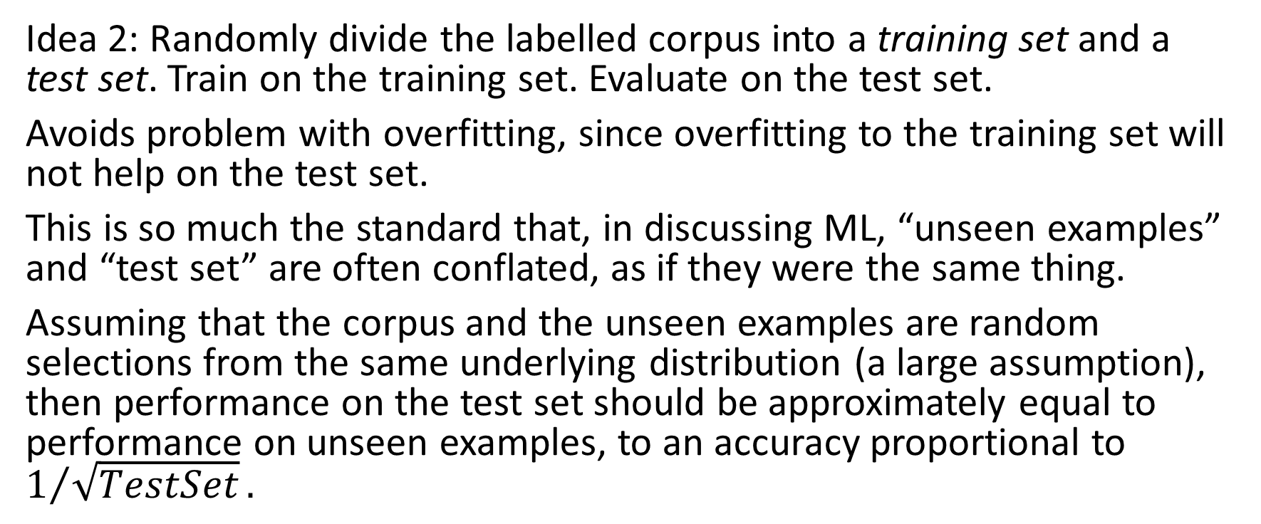
Training set and test set
Idea 2: Randomly divide the labelled corpus into a training set and a test set. Train on the training set. Evaluate on the test set.
Avoids problem with overfitting, since overfitting to the training set will not help on the test set.
This is so much the standard that, in discussing ML, “unseen examples” and “test set” are often conflated, as if they were the same thing.
Assuming that the corpus and the unseen examples are random selections from the same underlying distribution (a large assumption), then performance on the test set should be approximately equal to performance on unseen examples, to an accuracy proportional to $1/{\sqrt{TestSet}}.$

Slide 12
Problem
Suppose:
You have a task and a labelled corpus, which you have divided into a training and a test set.
You have run fifty different ML algorithms (or architectures), each with fifty different settings on meta-parameters. You train each of them on the training set and test each of them on the test set.
If you publish all 2500 results, reporting the results on the test set, that’s fine.
If you choose the best algorithm and the best setting and just report that, then the number you report is not reliable. Even though it’s the same number as in (a).

Slide 13
Explanation
There will be a certain amount of variance in performance, just due to chance. If you choose the best performing one, then you don’t know whether its performance was because it actually performs well, or was just lucky.
Extreme example: Suppose that the task is to predict a coin toss, and the test set has 10 coin flips. Suppose that with a training set of coin flips, all the ML algorithms end up effectively guessing at random. Since there are only 1024 possible outcomes, there is a .92 chance that one of the 2500 algorithms will score 100%. But, of course, on future flips, it will only score 0.5.

Slide 14
To avoid this problem
Divide the labelled corpus into a training set, a validation set, and a test set.
Train individual ML algorithms on the training set.
Use the validation set to choose between them.
When that’s all done, use the test set to evaluate the apparent winner.
Once the results of a test set have been used in any way as a guide to action --- choosing an ML algorithm, setting metaparameters, guiding future research --- in principle, the test set is contaminated and a new test set should be chosen. In practice, it may not be a huge problem. But it is difficult to know how large a problem it is.

Slide 15
Another issue
Often you have a small corpus, and cannot afford to hold back a large fraction for testing.
K-fold testing. Divide the corpus into k parts P₁ … P_{k}.
For i=1..k, train on T-P_{i}, and test on P_{i}. Average the test results.
Extreme version: “Leave one out”. Same thing, with k=N. So for each instance X in the training set, you train on everything except X then test on X and see the fraction correct overall.
Hard to justify theoretically. Often works well in practice.

